Slide 1
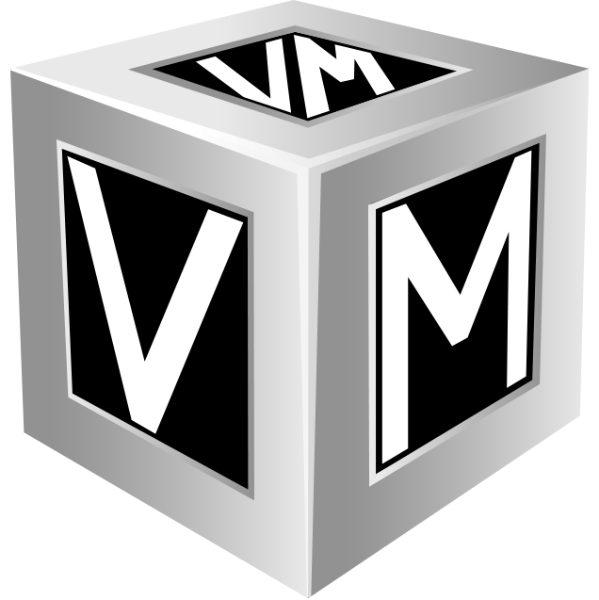
VMware and Alternatives
Straight Answers to Tough Questions
Presented by: VMsources Group Inc.

Slide 2
Agenda
VMware and alternatives
  Introduction
  Why consider alternatives to VMware?
  Choices: VMware and realistic alternatives
  Hypervisors / Platforms compared
  VMware
  Proxmox VE
  Hyper-V
  Nutanix
Vendor-Agnostic Reference Architecture
  Cluster Design and Deployment
  Hyperconverged Storage (HCI)
  Traditional SAN
  Cluster Sizing
  Cluster Performance
  Why a 3-Node Cluster?
  HCI Cluster Design
  Traditional Cluster Design
  “The Fine Print”
Copyright © 2025, VMsources Group Inc. All Rights Reserved

Slide 3
Why consider alternatives to VMware?
Cost and/or perception of cost for VMware
Perceived loss of value/equity in VMware licensing under Broadcom
VMware licensing options under Broadcom
Future of VMware development/support
Copyright © 2025, VMsources Group Inc. All Rights Reserved
Notes:
VMware vSphere is the undisputed market leader, and we still consider it to be the best overall platform available.
Unfortunately, through the Broadcom acquisition, many vSphere users have become dissatisfied.
Either they perceive the cost of vSphere under Broadcom to be too high or they don’t like the way Broadcom has handled the transition.

Slide 4
VMware and realistic alternatives
VMware vSphere
Microsoft Hyper-V
Nutanix
Proxmox
Others?
Copyright © 2025, VMsources Group Inc. All Rights Reserved
Notes:
In considering an alternative to VMware, there are several main elements to consider beyond simple cost:
Is it easy to use?
How is support?
Is it scalable, and how easily?
How will it integrate with my existing software and backup solution?
In this presentation, we will be covering: VMware vSphere, Proxmox VE, Microsoft Hyper-V and Nutanix
Bottom line is this: We might like to drive a Mercedes, but we all know that a Chevy or Honda will get us to our destination!

Slide 5
VMware vSphere
Advantages
Disadvantages
Most widely used and trusted platform
Single-pane-of-glass management with vCenter
Highly scalable
Core X86 architecture
HCI with vSAN is native
Supported by many Business Continuity suites
Cost / perceived cost
Extra cost for Hyperconverged storage with vSAN
Future of product development & support
Limited hardware compatibility
Trial/free version available?
Copyright © 2025, VMsources Group Inc. All Rights Reserved
Notes:
VMware vSphere has numerous advantages, with several important questions hanging in the balance.
What’s clear is that Broadcom has changed the terms and cost of choosing vSphere as your Infrastructure platform.
While we’ve stated that we feel that vSphere is still the best technical platform (from both an operational ang Infrastructure management perspective), it may no longer fit with your Organizations budget or guidelines.

Slide 6
Comparison of vSphere Licenses core features
vSphere Enterprise Plus
vSphere Standard
vSphere Essentials Plus
vCenter Standard
Distributed Resource Scheduler (DRS)
Distributed vSwitch
vMotion
Storage vMotion
High Availability (HA)
vCenter Standard
vMotion
Storage vMotion
High Availability (HA)
vCenter Essentials
vMotion
High Availability (HA)
vSphere Editions Compared: https://www.vmware.com/docs/vmw-datasheet-vsphere-product-line-comparison
Copyright © 2025, VMsources Group Inc. All Rights Reserved
Notes:
Even with the new VMware/Broadcom licensing options, there are three basic feature-sets available.
vSphere Enterprise Plus features are available in any of the “Foundation” licenses, with some vSAN entitlement.
vSphere Standard is available per core with a 16 core/CPU minimum per server and a 72 core/license minimum per contract.
While vSphere Essentials Plus is still technically a possibility, run the numbers and you will find it usually doesn't make sense anymore.

Slide 7
VMware Subscriptions, Packaging and Pricing
Package | Per Core MSRP | Licenses Included/Notes
vSphere Cloud Foundation | $350 | vSphere Enterprise Plus, vSAN Enterprise, Aria Suite Enterprise, NSX Networking for VCF, HCX Enterprise, Aria Operations for Networks Enterprise, SDDC Manager
 |  | vSAN Enterprise 1 TiB free per-core licensed to be included in vSphere Cloud Foundation software release
vSphere Foundation | $135 | vSphere Enterprise Plus, vCenter Server Standard, Tanzu Kubernetes Grid, Aria Suite Standard, available Add-On's
 |  | vSAN Enterprise 0.25TB per-core licensed to be included in vSphere Foundation software release
vSphere Standard | $50 | vSphere Standard, vCenter Server Standard
vSphere Essentials Plus Kit | $35 | vSphere Essentials Plus, vCenter Server Essentials
 |  | *sold per 96-core kit, maximum of 3 hosts
Source: https://community.veeam.com/blogs-and-podcasts-57/decoding-the-new-broadcom-vmware-vsphere-licensing-packages-for-small-deployments-6398
Copyright © 2025, VMsources Group Inc. All Rights Reserved
Notes:
While your Organization may have previously licensed vSphere Enterprise Plus, it is important to really examine your needs.
Maintaining Enterprise Plus features now requires a “Foundation” license at a significant cost increase.
Many Organizations may find that they can do fine with vSphere Standard.
In fact, the significant loss to many Organizations that opt for vSphere Standard in place of an existing vSphere Standard license will be the vSphere DRS feature which automatically balances loads across the cluster. This can be mitigated by more diligent management of the vSphere environment.
Users of vSphere Distributed vSwitches would also need to convert to vSphere Standard vSwitches if downgrading to vSphere Standard.
Other feature availability issues which would be encountered by users considering downgrading from vSphere Standard to vSphere Standard should be considered on a case-by-case basis: https://www.vmware.com/docs/vmw-datasheet-vsphere-product-line-comparison

Slide 8
CPU Cores for VMware Clusters
Choosing the correct number of cores for your VMware ESXi hosts is important
  Broadcom has a minimum license requirement of 16 cores/CPU
    More than 16 cores/CPU and you will need to buy additional licenses
    Fewer than 16 cores/CPU and you will still need to license 16 cores/CPU
Fast 16 core CPUs give you more bang for the buck over time with VMware/Broadcom
CPU Choice | vSphere STD/yr/cluster& | Total CPU
12 cores/CPU X 6 CPUs@ 2.4 Ghz. (legacy cluster) | $4,800* | 172.6 Ghz.
24 cores/CPU X 6 CPUs @ 2.4 Ghz. (typical cluster) | $7,200 | 345.6 Ghz.⁺
16 cores/CPU X 6 CPUs @ 3.6 Ghz. (optimized cluster) | $4,800 | 345.6 Ghz.#
&Cluster size = 3 hosts / 6 CPUs
*12 core CPUs will be licensed at 16 cores due to Broadcom license terms
⁺24 core CPUs are affordable, but will cost more annually in your VMware/Broadcom license and typically have a lower speed
#16 core CPUs @ 3.4 Ghz. cost a little more, but yield the same COMPUTE for a lower annual license cost
Copyright © 2025, VMsources Group Inc. All Rights Reserved
Notes:
Choosing the correct CPUs for your vSphere cluster can be very important.
Legacy clusters with fewer than 16 cores/CPU suffer from the requirement of licensing a minimum of 16 cores/CPU. In other words, you will pay for cores which you can not use.
Many hardware vendors will try to sell you high core-count CPUs on which they make a greater margin. Don’t fall for it. High core count CPUs typically run slower than 16-core CPUs and may end up yielding the same COMPUTE for a much higher annual VMware/Broadcom license cost.
For VMware/Broadcom, we recommend the Intel Xeon GOLD 6444Y 3.6GHz 16C CPU as achieving the maximum COMPUTE for the annual VMware/Broadcom license cost.

Slide 9
VMware Licensing Cost
vSphere Licensing Options
 | Single host with 2 X 8-Core CPUs | 3-Host cluster with 6 X 16-core CPUs | 3-Host cluster with 6 X 24-core CPUs
vSphere Standard ^{A} | $3,600/year (72 cores/contract) | $4,800/year (vSAN not included) | $7,200/year (vSAN not included)
vSphere Foundation ^{B} | $9,720/year (72 cores/contract) | $12,960/year (vSAN up to 24 TB) | $19,440/year (vSAN up to 36 TB)
vSphere Cloud Foundation ^{C} | $25,200/year (72 cores/contract) | $33,600/year (vSAN up to 96 TB) | $50,300/year (vSAN up to 144 TB)
vSphere Essentials Plus Kit ^{D} | $3,360/year | $3,360/year (vSAN not included) | Not Available, exceeds 96 core capacity
vSphere “fine print” ^{A} vSphere Standard, vCenter Server Standard ^{B} vSphere Enterprise Plus, vCenter Server Standard, 0.25TB/core vSAN Enterprise ^{C} vSphere Enterprise Plus, vCenter Server Standard, 1TB/core vSAN Enterprise ^{D} vSphere Essentials Plus, vCenter Server Essentials, per 96-core kit, maximum 3 hosts
Copyright © 2025, VMsources Group Inc. All Rights Reserved
Notes:
Here is a comparison of real-world licensing costs for VMware vSphere.
You can see from the table that standalone licensing of single host or even two-host ESXi installations is no longer economically practical, though it may remain practical if your Organization licenses enough single host or two host clusters to meet the minimum 72 core/contract.

Slide 10
Real-World CAPEX for VMware Clusters
VMware with traditional SAN
VMware with vSAN
3-node HPE cluster ($104,000)
  6 X Intel 6444Y 3.6GHz 16C CPU
  576 GB RAM
  6 X 1TB Install SSD
  18 TB NET HPE MSA iSCSI SAN
  3-yr Tech Care Essential Warranty
On-Site installation 4-days
3-node HPE cluster ($127,000)
  6 X Intel 6444Y 3.6GHz 16C CPU
  576 GB RAM
  6 X 1TB Install SSD
  16 TB vSAN NET
    6 X 1TB Cache Disks
    12 X 4 TB Capacity disks
  3-yr Tech Care Essential Warranty
On-site installation 4-days
Copyright © 2025, VMsources Group Inc. All Rights Reserved
Notes:
These prices are based on recent quotes to our customers, we’re confident we can offer you the best price possible. Be advised, however, prices are now affected by tariffs and will increase by 20% or more in the very near future!
What we’ve done is create a solid cluster with middle-of-the-road capacity suitable for many of our clients across industry silos.
All the hardware is the latest HPE G11 nodes with 100% HPE OEM inclusions. In other words, we didn’t cheap-out on the disks!
In the case of the iSCSI SAN, it’s a HPE MSA 2060 with dual 10 GbE controllers which are down-ratable to 1GbE for environments which don’t have 10 GbE network available.
The prices include VMsources coming to your location anywhere in CONUS to perform installation (and migration if required) as well as knowledge-transfer with your team over a 4-day period

Slide 11
CAPEX + OPEX for VMware Clusters
 | vSphere Standard w/iSCSI SAN | vSphere Foundation w/iSCSI SAN | vSphere Cloud Foundation w/vSAN
CAPEX
Cluster Hardware | $95,000.00 | $95,000.00 | $116,000.00
On-prem Installation | $9,000.00 | $9,000.00 | $9,000.00
TOTAL CAPEX: | $104,000.00 | $104,000.00 | $125,000.00
OPEX
MSP | $9,000.00 | $9,000.00 | $9,000.00
VMware | $4,800.00 | $12,960.00 | $33,600.00
TOTAL OPEX: | $13,800.00 | $21,960.00 | $42,600.00
Copyright © 2025, VMsources Group Inc. All Rights Reserved
Notes:
The options we’ve presented represent just a few of many possibilities, however they meet the needs of many VMware users today.
For many clusters, vSphere Standard is an acceptable licensing level and keeps OPEX to a minimum.
For more dynamic environments which require frequent load balancing and/or have complex network requirements, we’ve chosen vSphere Foundation for the example.
Unfortunately with vSAN, to obtain NET capacity requirements of about 16-18 TB NET storage we needed to specify vSphere Cloud Foundation.
As you can see, the cost to license vSphere ranges from almost $5,000 to over $30,000 annually.

Slide 12
VMware 60-Month TCO
Copyright © 2025, VMsources Group Inc. All Rights Reserved
Notes:
Over 60 months, the TCO for your vSphere cluster will range from about $173,000 to about $340,000.
Judge for yourself The TCO of the proposed VMware deployments over 60 months.

Slide 13
Proxmox VE
Advantages
Disadvantages
Cost
KVM Hypervisor
Wide hardware compatibility
HCI included at all license levels
Proxmox full feature Open-Source edition – no cost, no support
Supported by many Business Continuity suites
Has native backup/DRaaS Tools
Embedded migration from VMware
Native container support
Manageable only per cluster
Required Linux / technical skills
Copyright © 2025, VMsources Group Inc. All Rights Reserved
Notes:
Proxmox VE is one of the best alternatives to VMware. It’s one of the fastest growing hypervisors out there and it includes native tools to assist in migration from VMware.
Proxmox is also affordable, with all features available at every license level, including unlimited HCI storage with CEPH which is one of the most understood and reliable HCI architectures available.
Another great thing about Proxmox is that it has very wide hardware compatibility. While we recommend using new servers, Proxmox absolutely installs on server generations which are no longer supported by VMware.
On the downside, some advanced Linux and storage-management technical skills will be required to take full advantage of Proxmox, but that’s where VMsources can help.

Slide 14
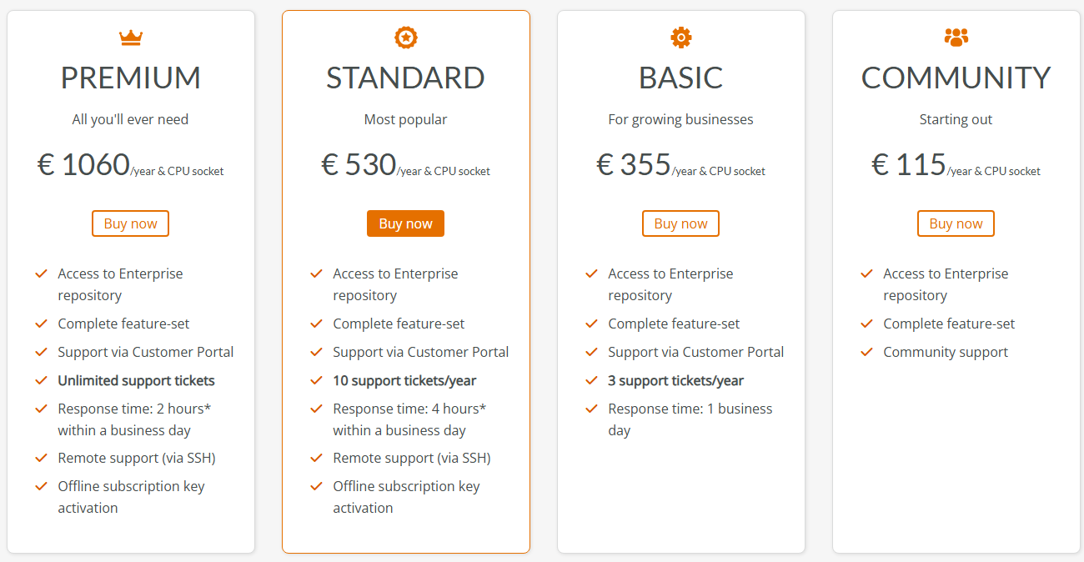
Proxmox VE Pricing
Copyright © 2025, VMsources Group Inc. All Rights Reserved
Notes:
Like VMware, Proxmox publishes clear and easy-to-understand pricing, and everyone pays the same thing.
Proxmox is licensed by CPU and not by core, so the highest core count or the fastest CPU speed will not affect your cost.
Even the Community edition of Proxmox includes every feature and unlimited storage options, only support differentiates the versions.
Furthermore, the Open Source version of Proxmox (which is free) supports all features, but not all repositories.
With the Open Source version of Proxmox, you may get packages and updates with differ from the licensed versions and stability of the platform may be affected.

Slide 15
Proxmox VE Licensing Cost
 | Single host with 2 X 8-Core CPUs | 3-Host cluster with 6 X 16-core CPUs | 3-Host cluster with 6 X 24-core CPUs
Proxmox VE Licensing Options
Proxmox VE Open-Source*¹ | €0/year | €0/year | €0/year
Proxmox VE Community*⁺ | €230/year | €690/year | €690/year
Proxmox VE Basic*^{+#} | €710/year | €2,130/year | €2,130/year
Proxmox VE Standard*^{+#} | €1,060/year | €3,180/year | €3,180/year
Proxmox VE Premium*^{+#} | €2,120/year | €6,360/year | €6,360/year
Proxmox VE “fine print” *All Versions Include Complete Feature Set including clustering and HCI CEPH Storage ⁺Access to Enterprise Repositories #Includes support tickets with Proxmox ¹No-Subscription Repository only
Copyright © 2025, VMsources Group Inc. All Rights Reserved
Notes:
Here is a comparison of real-world licensing costs for Proxmox VE.
Proxmox VE licenses per CPU, irrespective of cores/CPU. That means you may be able to take advantage of lower cost / higher core CPUs in you r cluster without penalty.
Also, there is no penalty for licensing single host or clusters smaller than 72 cores.

Slide 16
Real-World CAPEX for Proxmox Clusters
Proxmox VE with traditional SAN
Proxmox VE with HCI CEPH Storage
3-node HPE cluster ($104,000)
  6 X Intel 6444Y 3.6GHz 16C CPU
  576 GB RAM
  6 X 1TB Install SSD
  18 TB NET HPE MSA iSCSI SAN
  3-yr Tech Care Essential Warranty
On-Site installation 4-days
3-node HPE cluster ($127,000)
  6 X Intel 6444Y 3.6GHz 16C CPU
  576 GB RAM
  6 X 1TB Install SSD
  16 TB vSAN NET
    6 X 1TB Cache Disks
    12 X 4 TB Capacity disks
  3-yr Tech Care Essential Warranty
On-site installation 4-days
Copyright © 2025, VMsources Group Inc. All Rights Reserved
Notes:
These prices are based on recent quotes to our customers, we’re confident we can offer you the best price possible. Be advised, however, prices are now affected by tariffs and will increase by 20% or more in the very near future!
What we’ve done is create a solid cluster with middle-of-the-road capacity suitable for many of our clients across industry silos.
All the hardware is the latest HPE G11 nodes with 100% HPE OEM inclusions. In other words, we didn’t cheap-out on the disks!
In the case of the iSCSI SAN, it’s a HPE MSA 2060 with dual 10 GbE controllers which are down-ratable to 1GbE for environments which don’t have 10 GbE network available.
The prices include VMsources coming to your location anywhere in CONUS to perform installation (and migration if required) as well as knowledge-transfer with your team over a 4-day period

Slide 17
CAPEX + OPEX for Proxmox VE Clusters
 | Proxmox VE Standard w/iSCSI SAN | Proxmox VE Standard w/HCI CEPH Storage
CAPEX
Cluster Hardware | $95,000.00 | $118,000.00
On-prem Installation | $9,000.00 | $9,000.00
TOTAL CAPEX: | $104,000.00 | $127,000.00
OPEX
MSP | $9,000.00 | $9,000.00
Proxmox VE Standard | $3,180.00 | $3,150.00
TOTAL OPEX: | $12,180.00 | $12,180.00
Copyright © 2025, VMsources Group Inc. All Rights Reserved
Notes:
With Proxmox VE, the only difference between traditional iSCSI SAN and Hyperconverged (CEPH) storage is in the cost of the disks.
With larger Proxmox VE clusters (6+ hosts/cluster), CEPH really pays off in cost and performance, however with smaller clusters a traditional iSCSI SAN is still the price/performance winner.

Slide 18
Proxmox VE 60-Month TCO
Copyright © 2025, VMsources Group Inc. All Rights Reserved
Notes:
In looking at the TCO for Proxmox VE over 60-months, costs are even closer with only the CAPEX representing any difference.

Slide 19
Microsoft Hyper-V
Advantages
Disadvantages
Included with Windows Server
Supported by many Business Continuity suites
Wide hardware compatibility
180-day trial
Systems Center licensing extra
Complex management consoles
No native HCI options at this time
Struggle with scalability of networking and managing many networks
Copyright © 2025, VMsources Group Inc. All Rights Reserved
Notes:
Hyper-V is widely available and supported. It does MOST of the same things as the other platforms, excepting for native HCI.
To attain HCI with Hyper-V, you will need to deploy additional software which can convert the local storage on each Hyper-V Host to clustered, highly-available storage.
There are open source HCI platforms available which will run on Hyper-V at no additional cost such as PetaSAN, but most HCI users will want to opt for a supportable solution like StarWind
Or you could simply choose a traditional SAN deployment for your Hyper-V environment.

Slide 20
Real-World CAPEX for Hyper-V Clusters
Hyper-V with traditional SAN
  3-node HPE cluster ($104,000)
    6 X Intel 6444Y 3.6GHz 16C CPU
    576 GB RAM
    6 X 1TB Install SSD
    18 TB NET HPE MSA iSCSI SAN
    3-yr Tech Care Essential Warranty
  On-Site installation 4-days
Copyright © 2025, VMsources Group Inc. All Rights Reserved
Notes:
These prices are based on recent quotes to our customers, we’re confident we can offer you the best price possible. Be advised, however, prices are now affected by tariffs and will increase by 20% or more in the very near future!
What we’ve done is create a solid cluster with middle-of-the-road capacity suitable for many of our clients across industry silos.
All the hardware is the latest HPE G11 nodes with 100% HPE OEM inclusions. In other words, we didn’t cheap-out on the disks!
In the case of the iSCSI SAN, it’s a HPE MSA 2060 with dual 10 GbE controllers which are down-ratable to 1GbE for environments which don’t have 10 GbE network available.
The prices include VMsources coming to your location anywhere in CONUS to perform installation (and migration if required) as well as knowledge-transfer with your team over a 4-day period

Slide 21
Nutanix
Advantages
Disadvantages
Nutanix AHV Hypervisor (Based on KVM)
Nutanix Prism management console
Supported by many Business Continuity suites
Has native backup/DRaaS Tools
Migration tools from VMware
Trial: Nutanix CE
Cost
HCI only, traditional SAN discouraged or not supported
Limited HCL
Probably requires full hardware refresh
No published pricing
Copyright © 2025, VMsources Group Inc. All Rights Reserved
Notes:
Nutanix was one of the pioneers in HCI, originally offering their storage platform for use with other hypervisors like ESXi and Hyper-V
More recently, Nutanix has developed their own hypervisor called AHV, which is based on KVM
Nutanix offers a highly-integrated platform with built-in storage, network, backup and disaster recovery tools.
One distinct disadvantage of Nutanix is that they discourage or do not allow the use of traditional SAN systems.
That means that using existing supported SANs or economical bulk-storage SANs is not going to work directly and migrating to Nutanix will likely mean a complete hardware refresh.

Slide 22
Nutanix License Cost
Nutanix is proprietary and does not publish prices
Copyright © 2025, VMsources Group Inc. All Rights Reserved

Slide 23
Real-World CAPEX for Nutanix Clusters
Nutanix HCI Cluster
3-node HPE cluster ($127,000)
  6 X Intel 6444Y 3.6GHz 16C CPU
  576 GB RAM
  6 X 1TB Install SSD
  16 TB vSAN NET
    6 X 1TB Cache Disks
    12 X 4 TB Capacity disks
  3-yr Tech Care Essential Warranty
On-site installation 4-days
Copyright © 2025, VMsources Group Inc. All Rights Reserved
Notes:
These prices are based on recent quotes to our customers, we’re confident we can offer you the best price possible. Be advised, however, prices are now affected by tariffs and will increase by 20% or more in the very near future!
What we’ve done is create a solid cluster with middle-of-the-road capacity suitable for many of our clients across industry silos.
All the hardware is the latest HPE G11 nodes with 100% HPE OEM inclusions. In other words, we didn’t cheap-out on the disks!
In the case of the iSCSI SAN, it’s a HPE MSA 2060 with dual 10 GbE controllers which are down-ratable to 1GbE for environments which don’t have 10 GbE network available.
The prices include VMsources coming to your location anywhere in CONUS to perform installation (and migration if required) as well as knowledge-transfer with your team over a 4-day period

Slide 24
Vendor-Agnostic Reference Architecture
Straight Answers to Tough Questions
Copyright © 2025, VMsources Group Inc. All Rights Reserved

Slide 25
Cluster Design and Deployment
Maximizing your investment through smart choices
  Platform choice
  Hyperconverged (HCI) storage or traditional SAN?
  Cluster network speed
Copyright © 2025, VMsources Group Inc. All Rights Reserved
Notes:
When creating a cluster reference architecture, it all comes down to workload requirements vs. budgetary considerations.
You may want a Mercedes, but you probably know that a Chevy or Honda will get the job done.
There are many factors which will guide your reference architecture, but one of the first you might want to consider is the available network speed that will interconnect the cluster nodes.
If you can invest in 100 GbE network for the cluster interconnection, all options are on the table.
If the network is to be 10 GbE or even just 1 GbE, HCI storage may not realize its full performance potential.
Thereafter, it’s a relatively simple matter of choosing a Private Cloud platform, storage type and server nodes to suit your requirement.

Slide 26
Let’s consider Hyperconverged Storage (HCI)
Advantages
Disadvantages
Requires no traditional SAN
Potentially very fast
Scalable
Supports deduplication and encryption-at-rest
Inefficient disk use in smaller clusters
Cost of disks plus licensing may be prohibitive
May have limited hardware/disk compatibility
Copyright © 2025, VMsources Group Inc. All Rights Reserved
Notes:
On paper Hyperconverged Storage (HCI) can seem very desirable.
When presented by salespeople, it “eliminates extra hardware” and “provides a streamlined solution” with “unlimited scalability.”
It is important to understand HCI a little bit before diving in.

Slide 27
HCI Considerations
Requires 3 nodes for quorum
Requires 10GbE or faster networking
HCI provides availability through “Network RAID” or “Storage Policy”
You need to have at least one¹ full copy of all your data on an additional node if not two² additional nodes
  A 1 TB Virtual Machine running in a 3-node HCI cluster will either consume 2 TB or 3 TB
3-Node HCI Cluster 18 X 4 TB SSD (Capacity) and 6 X 1 TB (Cache)
4 TB | 4 TB | 4 TB | 1 TB
4 TB | 4 TB | 4 TB | 1 TB
 |  |  |  |  | 72 TB RAW
4 TB | 4 TB | 4 TB | 1 TB |  | 35 TB NET¹
4 TB | 4 TB | 4 TB | 1 TB |  | 24 TB NET²
4 TB | 4 TB | 4 TB | 1 TB
4 TB | 4 TB | 4 TB | 1 TB
¹ Primary level of failures to tolerate (PFTT) = 1
² Primary level of failures to tolerate (PFTT) = 2
Copyright © 2025, VMsources Group Inc. All Rights Reserved
Notes:
First of all HCI generally requires a minimum of 3 nodes to meet a quorum.
While some vendors/platforms will tout two node or even one node “HCI,” the reality is that this is just local storage on the hosts, which you can do for free with almost every hypervisor platform.
Therefore, to achieve NET capacity requirements with HCI, you need to provision enough disks (SSD/NVMe) to meet availability requirements.
This means that in smaller clusters, you will provision many mode disks (more RAW TB of storage) that the realized NET capacity.
While deduplication and compression are a part of many HCI platforms, paying for the additional disks and licensing the HCI platform separately (vSAN / Nutanix / StarWind) may not make economic sense.
It should be noted that with larger clusters of 6 nodes or more, HCI can really pay-off in cost, scalability and performance. N-1 and/or N-2 is less costly with 6+ nodes.

Slide 28
Traditional SAN
Traditional SANs:
  Use RAID to achieve availability and RAM for cache
  Present NET storage capacity after RAID
  Support deduplication and encryption-at-rest
Traditional SAN 10 X 4 TB SSD / RAID 6 (N-2)
4 TB | 4 TB | 4 TB | 4 TB | 4 TB |  | 40 TB RAW
4 TB | 4 TB | 4 TB | 4 TB | 4 TB |  | 32 TB NET
Copyright © 2025, VMsources Group Inc. All Rights Reserved
Notes:
Traditional SANs achieve availability through RAID and cache through their controllers.
With a traditional SAN, you will need far fewer disks to achieve the same NET storage capacity as a HCI cluster.
Moreover, support costs for a traditional SAN will be far less than licensing cost for many vendor’s HCI solution.
A traditional SAN with SSD or NVMe disks and 10GbE or better network will also provide blazing fast storage for your environment, while potentially supporting deduplication and/or encryption-at-rest.

Slide 29
Cluster Sizing
Determine total workload requirement
Build in expected growth
Size your cluster N-1 (up to 8 nodes) or N-2 (9-16 nodes) to accommodate maintenance / node failure
Right-size the CPU to minimize licensing cost
Choose storage to meet capacity needs
With multiple cluster locations, consider deploying uniform server specifications to facilitate hardware interchangeability
Copyright © 2025, VMsources Group Inc. All Rights Reserved
Notes:
Many vendors make a big deal about cluster sizing. They’re gonna use various tools and “scanners” to produce a beautiful report that recommends the solution they wanted to sell you in the first place.
The thing is, it’s just not that complicated!
Sum the total CPU and RAM requirement, factoring in utilization for individual systems. Determine storage requirement regarding capacity, performance and encryption-at-rest. Build-in expected growth and availability requirements.
Then you will have determined your cluster size requirement in terms of:
Total Ghz. of CPU
Total GB of RAM
Total TB of storage
At VMsources, it typically takes us one to two days to do a comprehensive sizing report with no BS

Slide 30
Cluster Performance
Cluster performance requirements will dictate many aspects of reference architecture requirements
  Are there applications which require a minimum CPU speed?
  Are there databases or other storage-performance sensitive workloads?
Copyright © 2025, VMsources Group Inc. All Rights Reserved
Notes:
Two simple questions will guide reference architecture for your cluster regarding performance:
Are there applications which require a minimum CPU speed?
Are there databases or other storage-performance sensitive workloads?
For the most part, choosing a CPU with a base speed of 3.0 Ghz. or higher will satisfy application requirements.
But for storage, it’s more complicated. Certain databases and other applications will dictate ultra-low-latency storage.
An all SSD or NVMe storage deployment with reasonable cache will likely meet requirements and exceed all expectations.
However, for the most demanding applications, choosing a storage solution with a large, dedicated cache in RAM (not disk cache) will be required.

Slide 31
Why a 3-Node Cluster?
3-node clusters are the meat and potatoes of Private Cloud computing
  Scalable to support hundreds of high-performance workloads
  Higher speed network with less physical switch traffic
  More economical licensing
  Less power consumption
  Smaller footprint
3-node clusters can be configured with up to:
  2995 Ghz. (768 cores)
  6 or more TB of RAM
  72 HDD / SSD / NVMe drive slots
  Enough Compute for several hundred high-performance workloads
Copyright © 2025, VMsources Group Inc. All Rights Reserved
Notes:
The concept of cluster size is distinctly different from the number of nodes required in that cluster.
While you might think that workload requirements dictate more hosts, we’d like to propose that a three node cluster will accommodate a significant percentage of Private Cloud deployments today.
With CPUs up to 128 cores at 3.9 Ghz. and individual nodes easily provisioned with 2 TB or more RAM *
Three-node clusters can be configured with up to 2995 Ghz. across 768 cores and 6 or more TB of RAM, providing enough Compute for several hundred high-performance workloads.
Furthermore, unless you have 100 GbE network interconnecting the nodes, a three node cluster will have much higher-speed network between workloads co-located on the same node.
A three-node cluster satisfies the quorum requirements of HCI and N-1 availability across a wide variety of deployments
*https://www.intel.com/content/www/us/en/products/sku/240777/intel-xeon-6980p-processor-504m-cache-2-00-ghz/specifications.html

Slide 32
HCI Cluster Design
 |  | HCI Cluster: 6 X Boot, 6 X Cache, 18 X 4 TB Capacity
HCI Node 1
 |  |  | 1 TB | 1 TB | 1 TB | 1TB | 4 TB | 4 TB | 4 TB | 4 TB | 4 TB | 4 TB |  | 16-Core X86 @ 3.6 Ghz. |  |  |  | 16-Core X86 @ 3.6 Ghz.
HCI Node 2
 |  |  | 1 TB | 1 TB | 1 TB | 1 TB | 4 TB | 4 TB | 4 TB | 4 TB | 4 TB | 4 TB |  | 16-Core X86 @ 3.6 Ghz. |  |  |  | 16-Core X86 @ 3.6 Ghz.
HCI Node 3
 |  |  | 1 TB | 1 TB | 1 TB | 1 TB | 4 TB | 4 TB | 4 TB | 4 TB | 4 TB | 4 TB |  | 16-Core X86 @ 3.6 Ghz. |  |  |  | 16-Core X86 @ 3.6 Ghz.
Legend |  |  | Boot |  | Cache |  | Capacity |  | Empty |  |  |  |  | CPU
Copyright © 2025, VMsources Group Inc. All Rights Reserved
Notes:
HCI Clusters require four things to be successful:
A quorum of at least three nodes
Storage devices on each node
CPU and RAM resources dedicated to HCI from the cluster total resources
High speed network interconnecting the nodes
These days, even 1U server nodes can be provisioned with 10 storage devices and 2U nodes with up to 24 storage devices.
NVMe or SSDs are commonly available in sizes up to 7.62TB each, so there should be no problem attaining the capacity requirements of your cluster.
This diagram represents a typical, small HCI cluster with between 24 and 35 TB of NET usable storage from a total of 24 storage disks

Slide 33
Traditional Cluster Design
 |  | Traditional SAN: 6 X Boot, 10X Capacity, Controller Cache
Traditional Node 1
 |  |  | 1 TB | 1 TB |  |  |  |  |  |  |  |  |  | 16-Core X86 @ 3.6 Ghz. |  |  |  | 16-Core X86 @ 3.6 Ghz.
Traditional Node 2
 |  |  | 1 TB | 1 TB |  |  |  |  |  |  |  |  |  | 16-Core X86 @ 3.6 Ghz. |  |  |  | 16-Core X86 @ 3.6 Ghz.
Traditional Node 3
 |  |  | 1 TB | 1 TB |  |  |  |  |  |  |  |  |  | 16-Core X86 @ 3.6 Ghz. |  |  |  | 16-Core X86 @ 3.6 Ghz.
SAN
 |  |  | 4 TB | 4 TB | 4 TB | 4 TB | 4 TB | 4 TB | 4 TB | 4 TB | 4 TB | 4 TB
Legend |  |  | Boot |  | Capacity |  | Empty |  |  |  |  |  |  | CPU
Copyright © 2025, VMsources Group Inc. All Rights Reserved
Notes:
A traditional SAN cluster does require an additional component, the SAN itself.
But let’s consider for a moment the actual number of devices deployed.
Using RAID 6, a SAN has far fewer actual storage devices than a HCI cluster to achieve the same NET capacity.
Furthermore, SANs use RAM to create cache which is very fast.
The choice between traditional SAN clusters or HCI clusters should boil down to economics:
Is it cheaper to buy disks and pay annual licensing (if any additional) for a HCI cluster or is it cheaper to buy a traditional SAN?
This diagram represents a typical, small SAN cluster with between about 32 TB of NET usable storage from a total of 10 storage disks

Slide 34
“The Fire Print”
Integrators and OEM vendors will often undersize their designs and quotes, just to get you to sign on the bottom line:
Leaves you holding the bag after deployment
You either stay the course and make excuses for needing more money
Or you admit you were wrong and fire the vendor
Some vendors will sell single-node or two-node “HCI” clusters
This is nothing more than local storage, possibly supplemented with backup or replication
Two-node HCI clusters with a “witness” node are feasible but risky
Deduplication / Compression can work well
Deduplication and compression requires considerable Compute resources from the cluster where applied, be sure to account for that in cluster sizing
Vendor “Appliances”
Vendor “appliances” can range the gamut, but you need to check the spec’s and make sure that latest-gen CPUs and sufficient RAM are provided.
Copyright © 2025, VMsources Group Inc. All Rights Reserved
Notes:
There’s a ton of unscrupulous vendors out there, and you really must look carefully at the fine print.
The biggest problem is vendors who propose undersized solutions or fail to disclose the licensing requirements needed to suit your mission-critical needs.
Unscrupulous vendors will deliberately use unrealistic estimates in creating your project, with an eye on presenting a financially attractive proposal.
Their goal is to get the decision-maker to endorse their solution and sign on the bottom line.
When it turns out that the deployed solution is insufficient or real-world costs are too high, the decision-maker is left holding the bag!

Slide 35
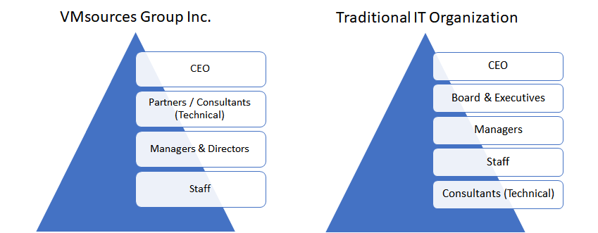
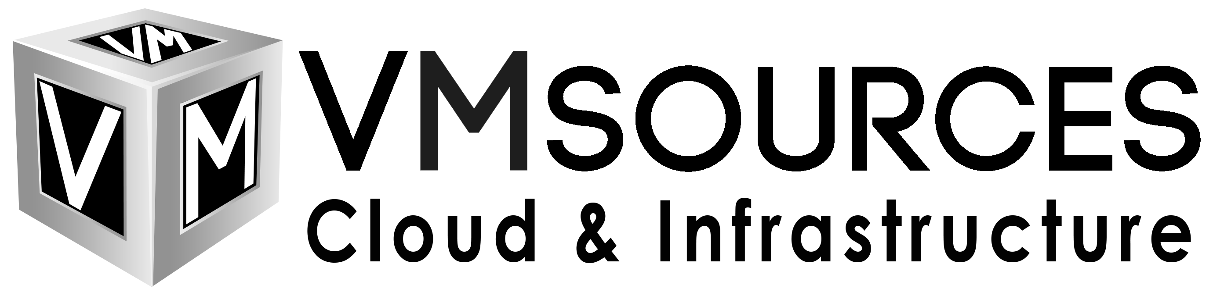
About VMsources
We are proud to bring the best technical guidance to the top of a traditional organizational structure.
Simplicity is elegance
VMsources is a customer-facing MSP specializing in Private Cloud, Infrastructure, and Network.
It is VMsources mission to act as the client's advocate at every stage of the project, from concept to completion.
https://vmsources.com
215-764-6442
Copyright © 2025, VMsources Group Inc. All Rights Reserved

